Slide 1
Rapid Test Continuous Quality Improvement (RTCQI)
Ms A Marsh: Deputy Director: HTS Program Manager

Slide 2
AGENDA
RTCQI Training - LMS
National Tester Certification
Proficiency Testing
SPI-RT Assessment Progress
RTCQI programme overview
Timeline – RTCQI Programme

Slide 3
TIMELINE

Slide 4
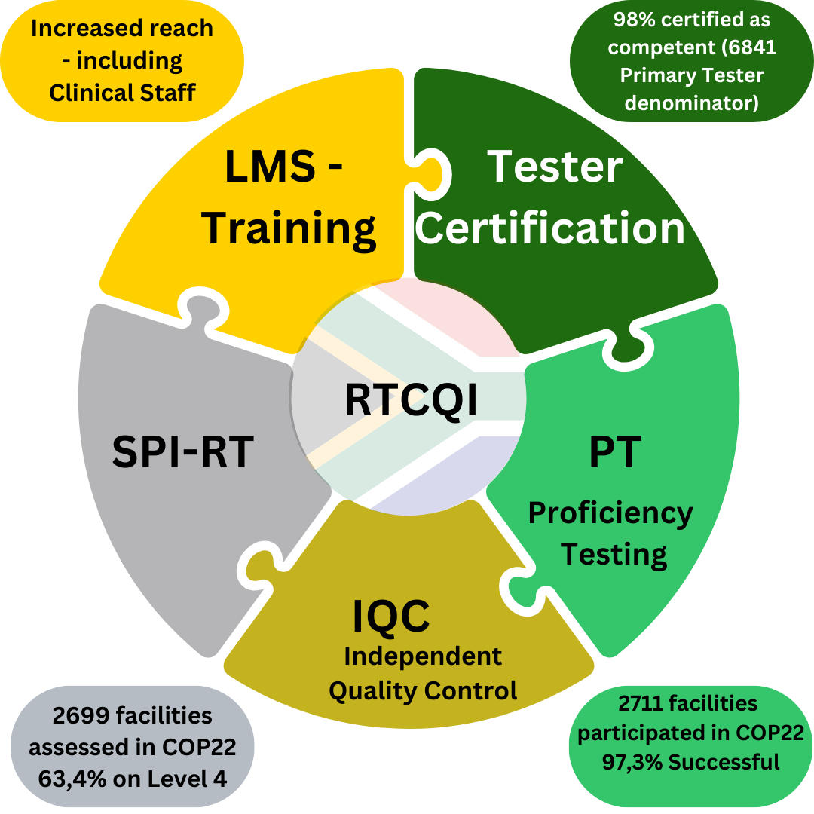
RTCQI PROGRAMME OVERVIEW
2024 – 6687 Testers certified (98%)
2020 – 10 Testers Certified (0,15%)
Total enrolment
onto LMS
7441
2023 – 2711 Participated, 97,3% successful
2020 – 1706 Participated, 92,7% successful
1719 sites on Level 4
2019 293 sites on Level 4

Slide 5
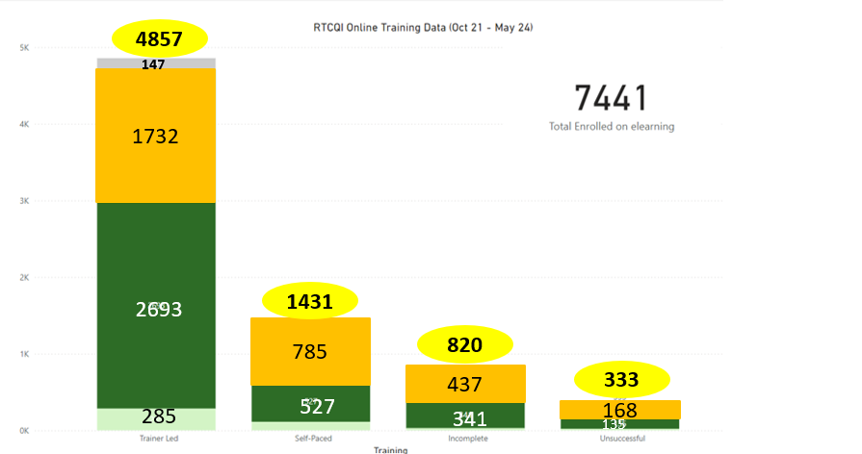
RTCQI TRAINING - LMS
Notes:
7441 learners enrolled nationally onto RTCQI training. 4857 received training via hybrid modality – instructor led. Only 1431 were enrolled as self-paced. 820 learners did not complete the course and 333 were deemed unsuccessful. The 7441 includes Professional Nurses, HTS Coordinators, DSP staff and DCS cadres.

Slide 6
NATIONAL TESTER CERTIFICATION
Target 80%
% in the COP year refers to contribution towards the goal.
Primary Tester Denominator & Progress: 6687/6841
Gaps: EC and WC (80% not achieved)

Slide 7
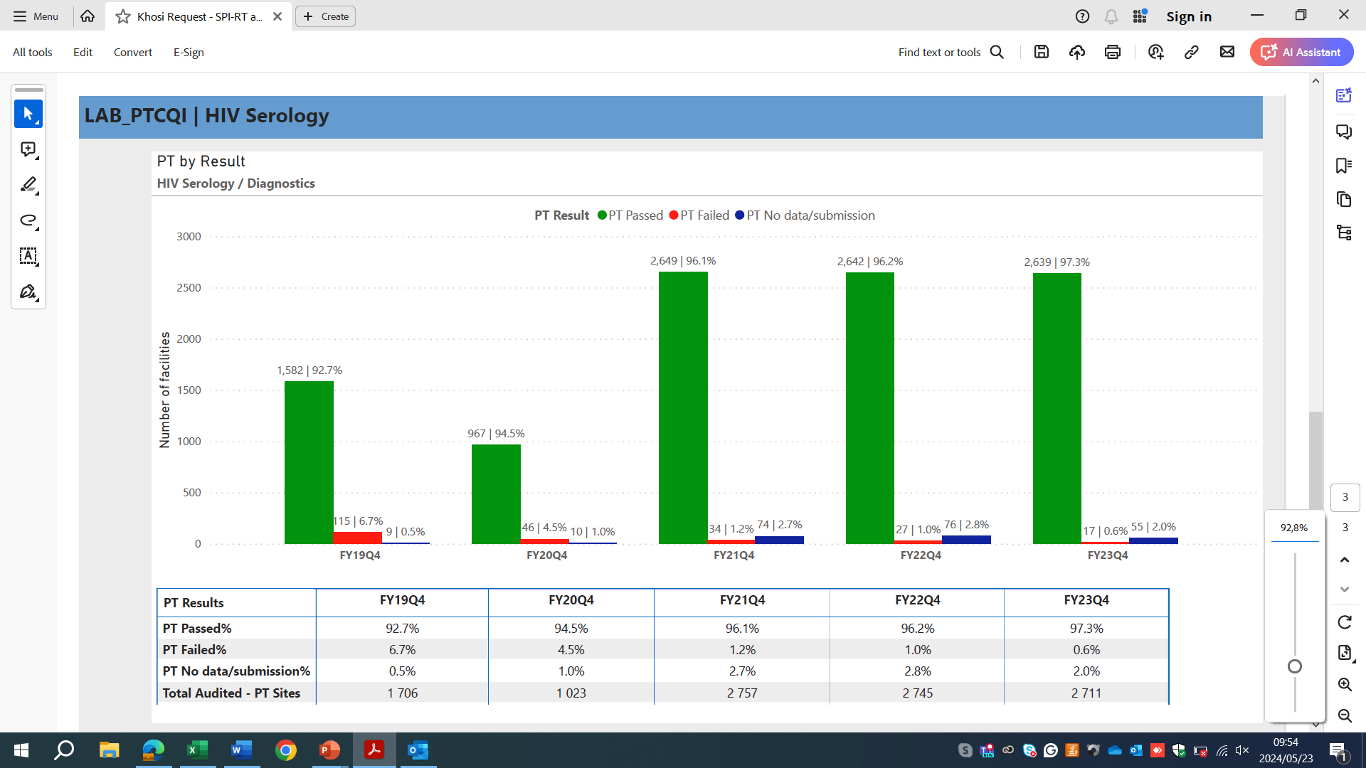
PROFICIENCY TESTING

Slide 8
SPI-RT ASSESSMENTS

Slide 9
SPI-RT ASSESSMENTS – ASSESSMENT AREAS
Section | SPI-RT Assessment Areas | 2019 | 2020 | 2021 | 2022 | 2023
 | Percentage scored | 83% | 85% | 90% | 89% | 91%
1 | Personnel Training and Certification | 47% | 51% | 62% | 68% | 75%
2 | Physical Facility | 93% | 94% | 96% | 94% | 94%
3 | Safety | 92% | 95% | 98% | 94% | 95%
4 | Pre/testing Phase | 90% | 93% | 95% | 95% | 96%
5 | Testing Phase | 87% | 90% | 94% | 90% | 92%
6 | Post/testing Phase & Documentation | 87% | 92% | 94% | 93% | 93%
7 | External Quality Audit | 88% | 86% | 93% | 93% | 93%
Contributing factors that enhanced Section 1:
Coordination and stakeholder engagement – inclusion and collaboration with DoH/DCS/DSP
Establishment and implementation of the Training and Certification Framework
Co-creation and coordinated rollout of the LMS – RTCQI modules
Coordination and mentoring linked to National Tester Certification

Slide 10
THANK YOU
SPECIAL THANKS TO
CDC, South Africa team
TB HIV/CARE

